Slide 1
Thriving Teams:
Preventing Burnout in the Workplace
COLLEEN DELVECCHIO
617.285.3564 | COLLEEN@MAXADY.COM WWW.MAXADY.COM
Notes:
Have white board open with what people think is the cause of their burnout

Slide 2
What exactly is burnout?
Notes:
The WHO now has included Burn-out in the 11th Revision of the International Classification of Diseases (ICD-11) as an occupational phenomenon. It is not classified as a medical condition.
The Mayo Clinic defines burnout is a special type of work-related stress — a state of physical or emotional exhaustion that also involves a sense of reduced accomplishment and loss of personal identity.
"Burnout" isn't a medical diagnosis. It typically occurs when you feel overwhelmed, emotionally drained, and unable to meet constant demands. As the stress continues, you begin to lose the interest and motivation that led you to take on a certain role in the first place.
Whatever the cause, job burnout can affect your physical and mental health.
The Ripple Effect: The negative effects of burnout spill over into every area of life—including your home, work, and social life. Burnout can also cause long-term changes to your body that make you vulnerable to illnesses like colds and flu.
Not surprisingly, the effects of burnout don’t stop when employees walk out the office door. Those who consistently experience high levels of burnout are two times more likely to strongly agree that the amount of time their job takes makes it difficult to fulfill their family responsibilities. Even scarier, burned-out employees are 23% more likely to visit the emergency room. 63% more likely to take a sick day.

Slide 3
Top 5 Causes of Burnout According to Gallup
Unfair treatment at work
Unclear communications from manager
Lack of manager support
Unreasonable time pressure
Unmanageable workload
Notes:
Unfair treatment at Work: When employees strongly agree that they are often treated unfairly at work, they are 2.3 times more likely to experience a high level of burnout. Unfair treatment can include all kinds of workplace issues, from bias, favoritism and mistreatment by a coworker to inconsistently applied compensation or corporate policies.
Unmanageable Workload: Employees who strongly agree that they always have too much to do are 2.2 times more likely to say they experience burnout very often or always at work. Even high-performing employees can quickly shift from optimistic to hopeless when they’re struggling with an unmanageable workload. But how people experience their workload has a stronger influence on burnout. Flexibility tends to lead to less burnout, even when working more hours.
Unclear Communication from Manager
Lack of Manager support: Manager support is central to preventing burnout. Manager support provides a psychological buffer, so employees know that their manager has their back — even when challenges arise or something goes wrong. Supportive managers are there for their team members, listening to their needs and encouraging them. They help their employees prepare and develop. Employees who strongly agree that they feel supported by their manager are about 70% less likely to experience burnout regularly.
Unreasonable Time Pressure: When employees say they very often or always have enough time to do all of their work, they are 70% less likely to experience high burnout. Unreasonable deadlines and pressure can create a snowball effect: When employees miss one overly aggressive deadline, they fall behind on the next thing they are scheduled to do.

Slide 4
Top 6 Causes of Burnout According to the Mayo Clinic
Lack of control over work decisions
Unclear job expectations from manager
Lack of social support
Extremes of activity
Dysfunctional workplace dynamics
Work-life imbalance
Notes:
Lack of control. An inability to influence decisions that affect your job — such as your schedule, assignments or workload — could lead to job burnout. So could a lack of the resources you need to do your work.
Dysfunctional workplace dynamics. Perhaps you work with an office bully, or you feel undermined by colleagues or your boss micromanages your work. This can contribute to job stress.
Unclear job expectations. If you're unclear about the degree of authority you have or what your supervisor or others expect from you, you're not likely to feel comfortable at work.
Lack of social support. If you feel isolated at work and in your personal life, you might feel more stressed.
Extremes of activity. When a job is monotonous or chaotic, you need constant energy to remain focused — which can lead to fatigue and job burnout.
Work-life imbalance. If your work takes up so much of your time and effort that you don't have the energy to spend time with your family and friends, you might burn out quickly.

Slide 5
5 Things to do Today to Limit the Effects of Burnout
Acknowledge that you/they are burnt out
Know and use your/their strengths
Talk to your boss/employees
Learn to say no
Take a break

Slide 6
What is your current level of burnout?
Never = 1
Rarely = 2
Sometimes = 3
Often = 4
All the time = 5
Notes:
I feel run down and drained physically.
I feel run down and drained emotionally
I am easily irritated by small problems.
I am easily irritated by my co-workers.
I feel like I am in the wrong career / industry / company.
I feel overwhelmed at work.
I have little patience for my co-workers.
I have trouble making decisions at work.
I lose my concentration when working on tasks.
I have trouble sleeping and / or relaxing.

Slide 7
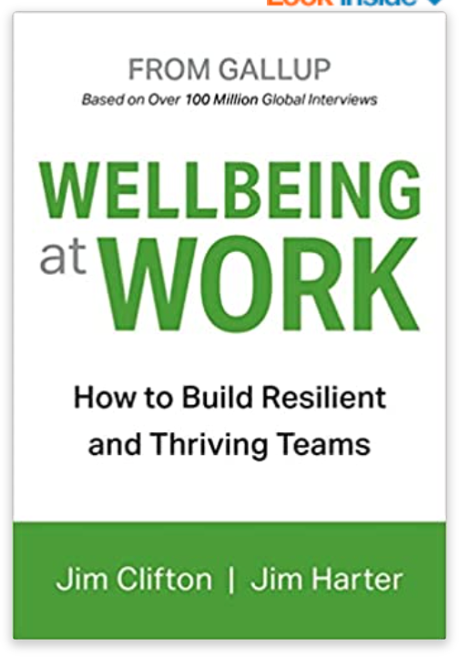
People who focus on their strengths
are 57% less likely to experience burnout frequently
are 6 times more engaged in their jobs
81% lower absenteeism
Notes:
Aim your strengths at your career
Why? When people have the opportunity to tap into their strengths, they are more engaged, more effective, less stressed and more focused on doing their best work — rather than seeing their job as a burden.

Slide 8
Talk to your boss
Know what you need…
and ask for it!
Flexibility
Better communication
Reasonable timelines
Office space
Consistency of work
Time off
Notes:
Don’t be afraid to talk with HR or your boss about your burnout.
Before you head into the conversation, have a plan in place and already have a few options for what would help you most. If that looks like being removed from a specific project or applying for a leave of absence, have your idea in mind along with a few other options handy. Walking in prepared with solutions will show your manager you are serious and want to take action, rather than that you are simply looking to vent frustrations.
"I've been feeling really burned out lately, and I have some ideas that would help me get back to being a better contributor to the team."
"I've been feeling a real sense of burnout lately, and I wanted to see what my options were to refresh my mind so that I can keep contributing to the best of my ability."

Slide 9
Make Wellbeing Part of Career Development Conversations
Have an annual goal be about wellbeing
Ability to use professional development funds for things like meditation apps or coaching
Ensure that employees schedule & take time off

Slide 10
Know your limits
What are giving up every time you say yes?
How can you say no?
“I’ll need to think about it.”
“Let me think / talk this through.”
”My priority is…”
“I’m not able to right now”
“Let’s find a work around.”

Slide 11
Take a break
Notes:
Get comfortable.
Begin by taking a deep breath in and then slowly letting it out through the mouth. Deep breathe in. Pause. Let it out.
Burnout tends to meet us when we are moving too fast for too long. It shows up when we are doing too much – typically for others – despite the negative effects it has on us.
We tend to go into reactive mode and not take the time to fill ourselves.
For the next 3 minutes or so, there are no expectations, no deadlines. Nothing but you and your chance to take a break.
Take a moment to close your eyes and bring attention to your breathing. Breathe in as deeply as you can and then slowly let it out. Breathe in through the nose and then let it out slowly through the mouth. As you continue to breathe, take a moment to notice what is happening in your body. Are you experiencing any tension in one particular area? Your head
Deep breathe in. Exhale.
Take a moment to
Gently wiggle your fingers and toes.
As you move into the rest of your day,
https://insighttimer.com/compassionatecreative/guided-meditations/burnout-meditation

Slide 12
What is the one thing you will do this week to decrease your/their level of burnout?
Colleen DelVecchio 617.285.3564 COLLEEN@MAXADY.COM WWW.MAXADY.COM

